Slide 1
2024-2050 POPULATION FORECASTS
Executive Committee
February 2, 2023
Notes:
As you might have seen, we just released our updated forecasts out to 2050 and I wanted to take this opportunity to walk you through it in more detail.

Slide 2
15-COUNTY REGION (0.89% CAGR)
Notes:
The short version is that our 15-county Central Ohio region is on track to reach nearly 3.15 million residents by 2050, which is a small uptick from previous projections.
Our recent growth places us among the fastest-growing large metros in the country. We are growing faster than any other region in the state, but at an estimated 0.89% annually, it is a much more manageable rate than metros, such as Austin or Boise, which have been growing at twice the rate of Central Ohio. (30% regional growth or about 20K annually).
Our region’s strong growth can be attributed, in part, to continued strong economic development. Although MORPC does not attempt to predict which firms will choose to establish operations in Central Ohio, our forecasting process anticipates development-induced growth, and plans for it. Communities must work to attract, retain, and develop firms that amplify existing industry clusters, add diversity to the region’s economy, and produce jobs in a variety of pay ranges and requiring an increasingly diversified talent pool.
Over the course of the next 25+ years, the Central Ohio region will see a growth of 726,000 people, which equates to 272,000 additional households and 357,000 additional workers.

Slide 3
15-COUNTY REGION GROWTH
Notes:
More specifically, over the course of the next 25+ years, Central Ohio will see a growth of 726,000 people, which equates to 272,000 additional households and 357,000 additional workers.

Slide 4
FRANKLIN COUNTY (0.80% CAGR)
Notes:
Franklin County will receive half of the newcomers, however the growth in surrounding counties will be more significant relative to their current populations

Slide 5
DELAWARE COUNTY (2.05% CAGR)
Notes:
80% growth total with an annual growth of 2.05%.

Slide 6
UNION COUNTY (1.38% CAGR)
Notes:
50% growth

Slide 7
PICKAWAY COUNTY (1.03% CAGR)
Notes:
30% growth

Slide 8
LICKING COUNTY (0.93% CAGR)
Notes:
30% growth

Slide 9


POPULATION GROWTH MAKE-UP
Notes:
Births and people moving to Central Ohio (in-migration) were almost equally contributing to the region’s growth in the past. However, Central Ohio, like the nation, is showing a continued trend of increased death rates and lower birth rates. This trend is in part due to our aging population, making it even more important to welcome new people to our region. Notable, Central Ohio is one of the only parts of the state that is currently benefitting from in-migration from other states and countries.

Slide 10
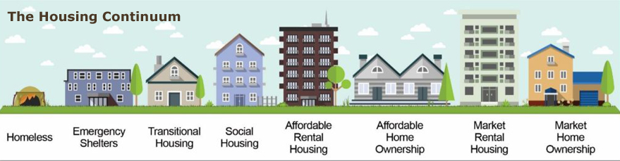
HOUSING NEED CONTINUES
Notes:
Over 100,000 new housing units will be required in the next decade. According to the Building Industry Association (BIA) of Central Ohio, housing permitting must increase approximately two-fold from recent trends to meet anticipated demand. A variety of housing options will be needed to satisfy the diverse needs of the region’s families and workers.

Slide 11
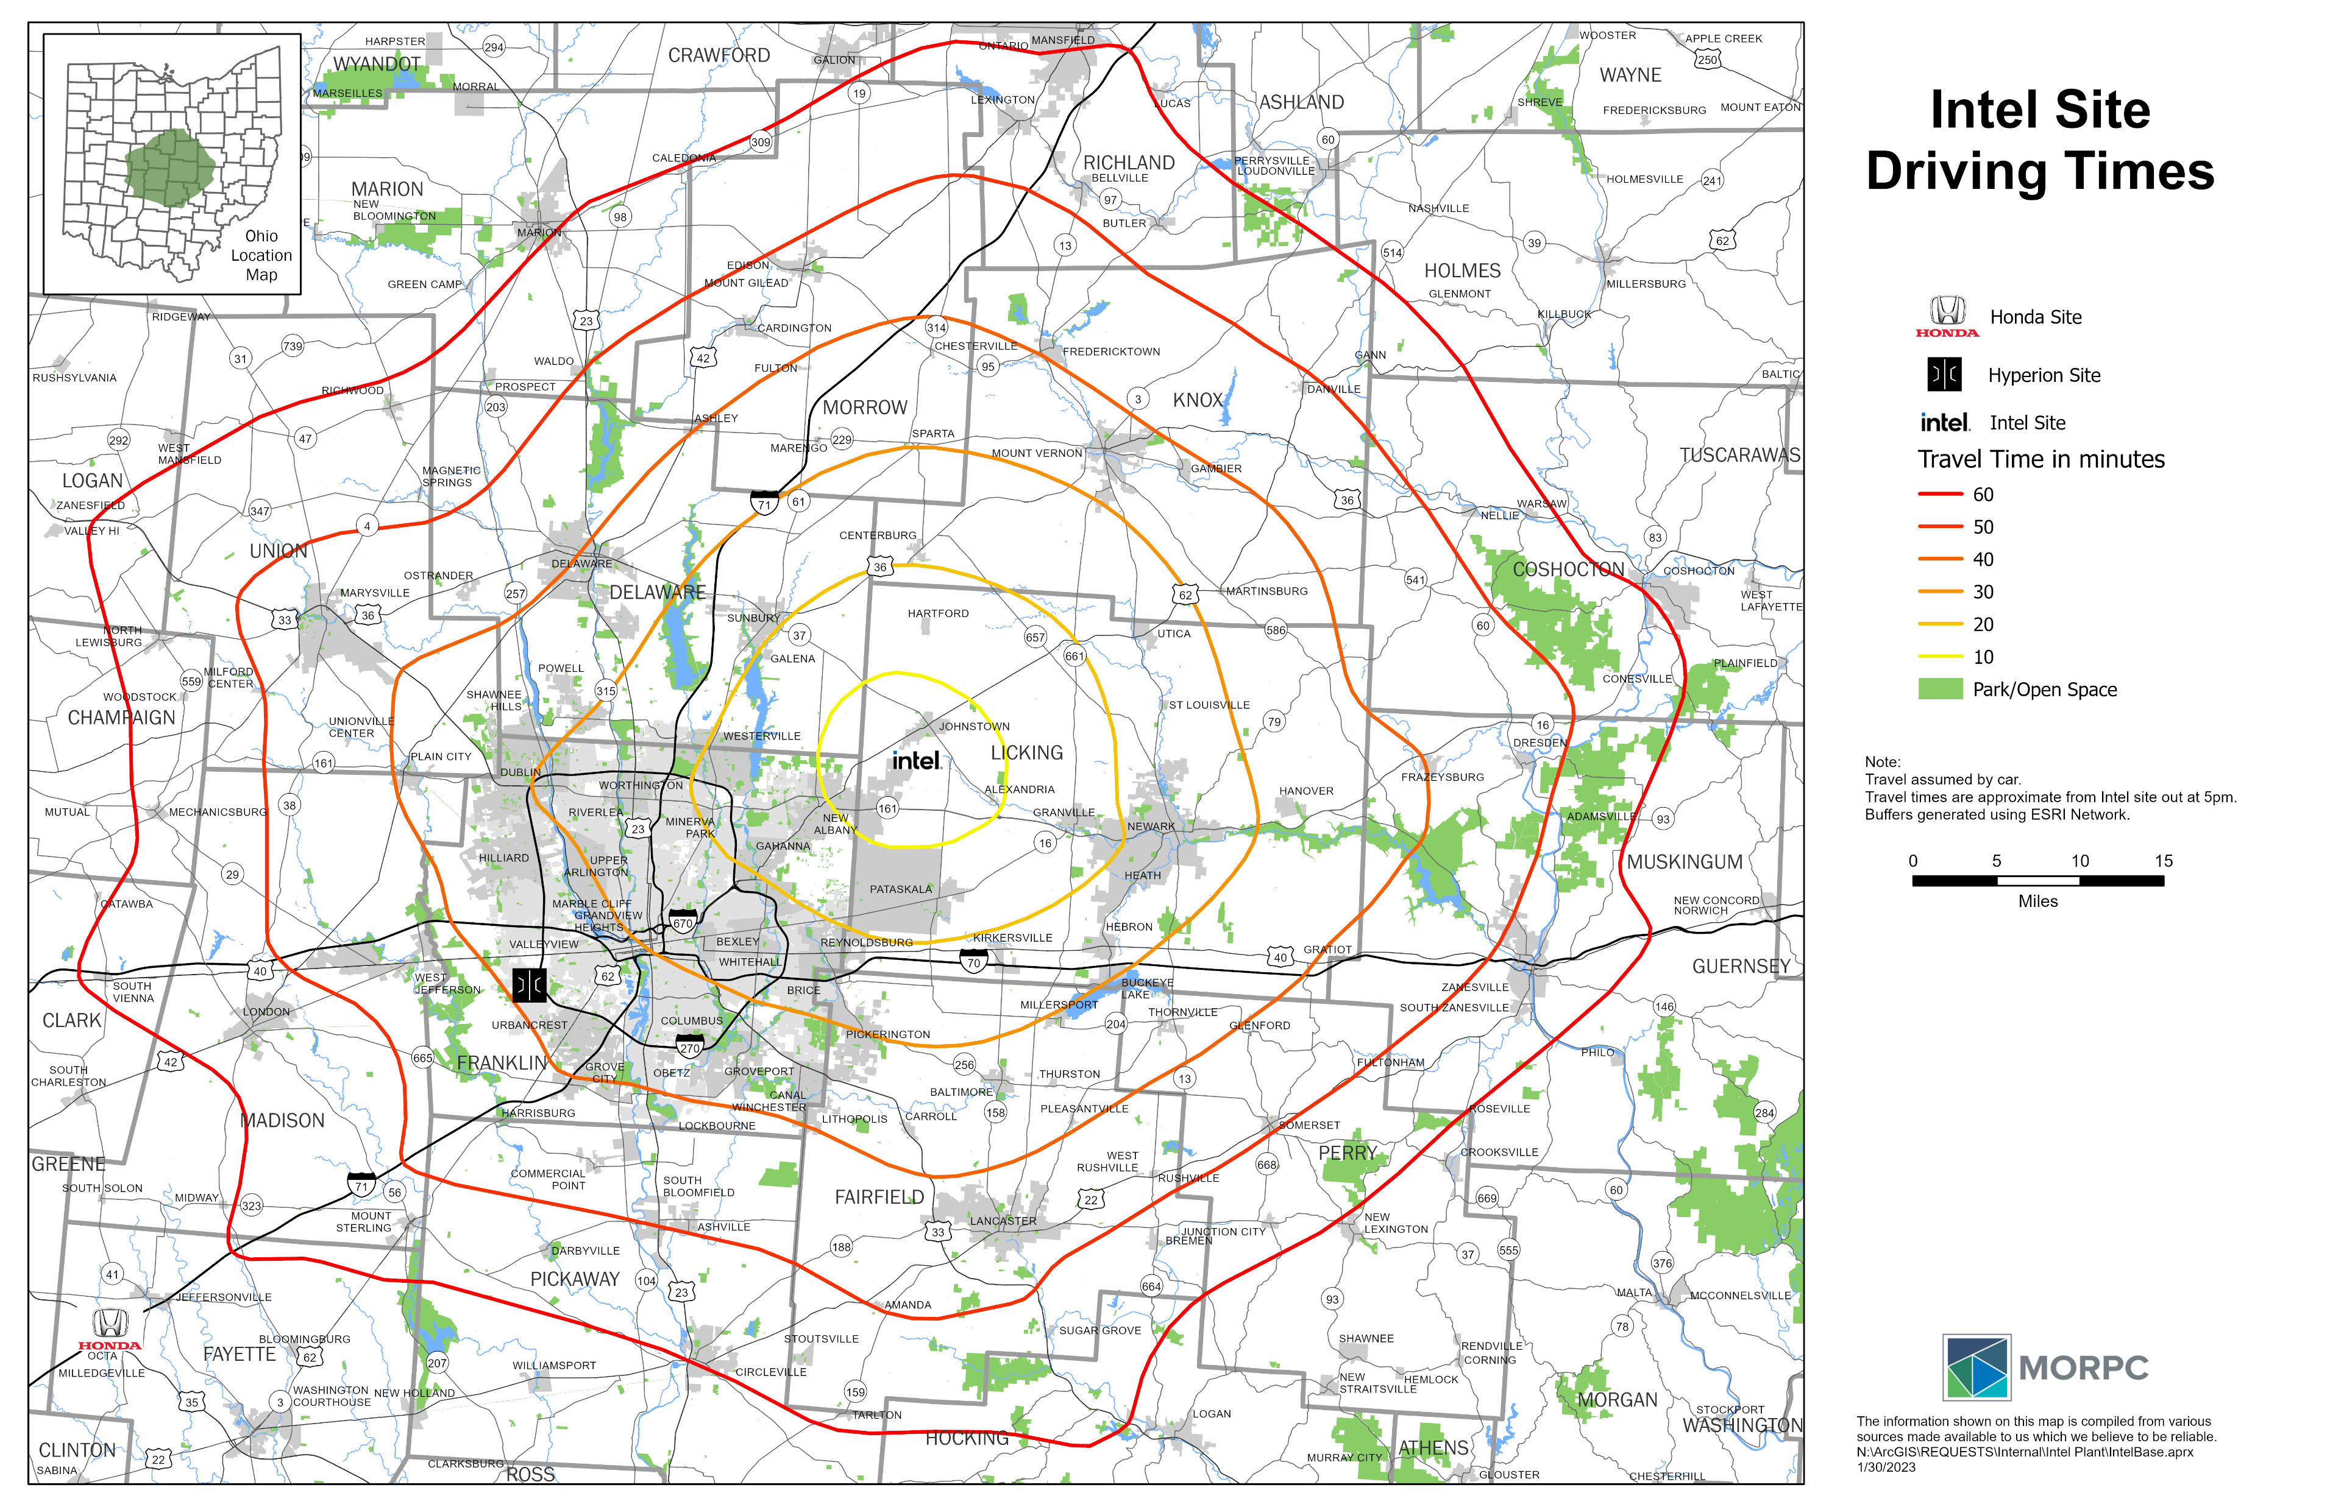
COMMUTING TIMES & PATTERNS
Notes:
More than 80% of Central Ohioans enjoy a commute time of less than 35 minutes to work. If communities wish to preserve this convenience as the region continues to grow, they must strive to develop housing near jobs and jobs near housing, locating new developments within close proximity to transit routes whenever practical. Thoughtful land use planning is also critical to improving air quality, reducing greenhouse gas emissions, and protecting our rivers and lakes from chemical runoff and stormwater impacts.

Slide 12

Kerstin Carr
Chief Regional Strategy Officer & Senior Director of Planning
Mid-Ohio Regional Planning Commission
T: 614.233.4163
kcarr@morpc.org
111 Liberty Street, Suite 100
Columbus, OH 43215

